Slide 1




Particle Size Distribution Optimization for Improved Fluid Flow of Thermoplastic-Silicon Nitride Slurries
Benjamin Künzler
Mentor: Mark Hawthorne

Slide 2
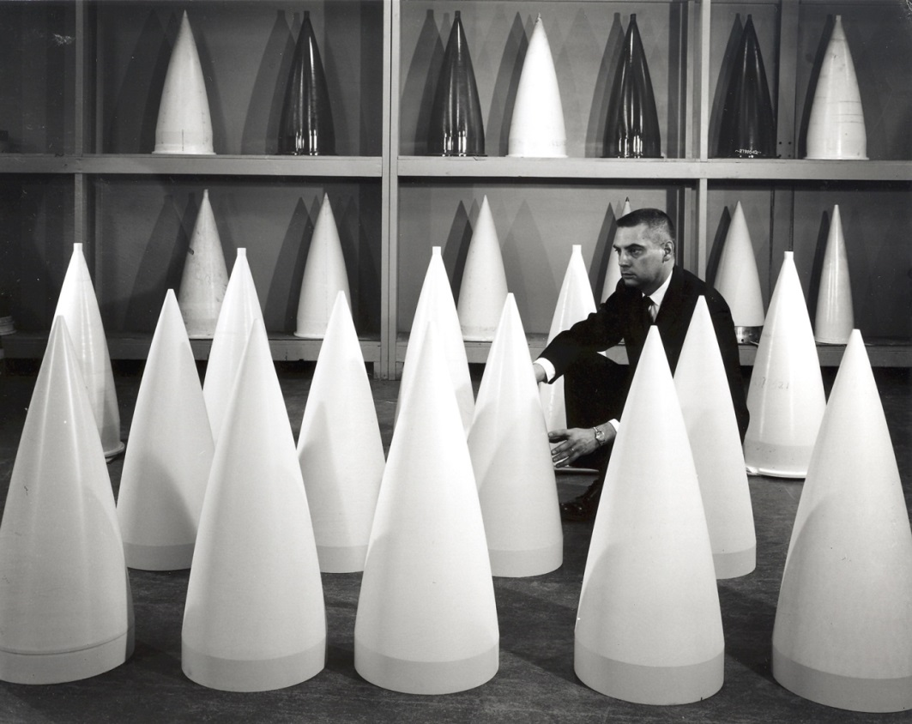
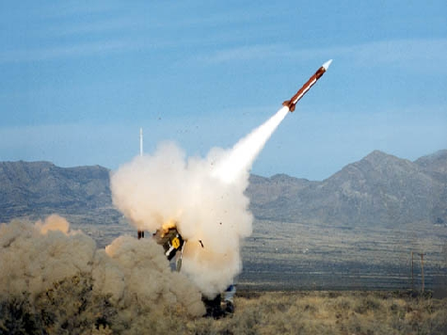
Purpose
To determine the optimal particle size of silicon nitride for improved fluid flow so that it can be molded into radomes.

Slide 3
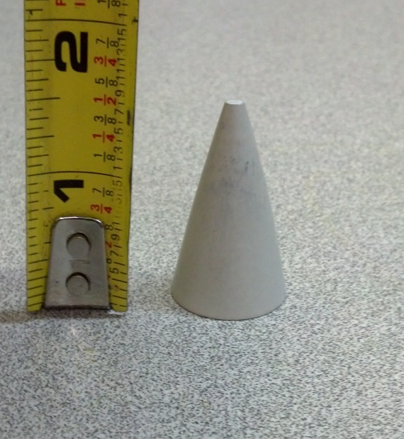
Problem
The current method of forming the radomes involves costly machining.
While near net shape radomes can be formed, the amount of binder used causes defects in the final product.
The viscosity of a slurry with the ideal amount of binder is too high for the molding process.
By determining an optimal particle size distribution of silicon nitride, the amount of binder will be reduced and fluid flow should be improved.

Slide 4
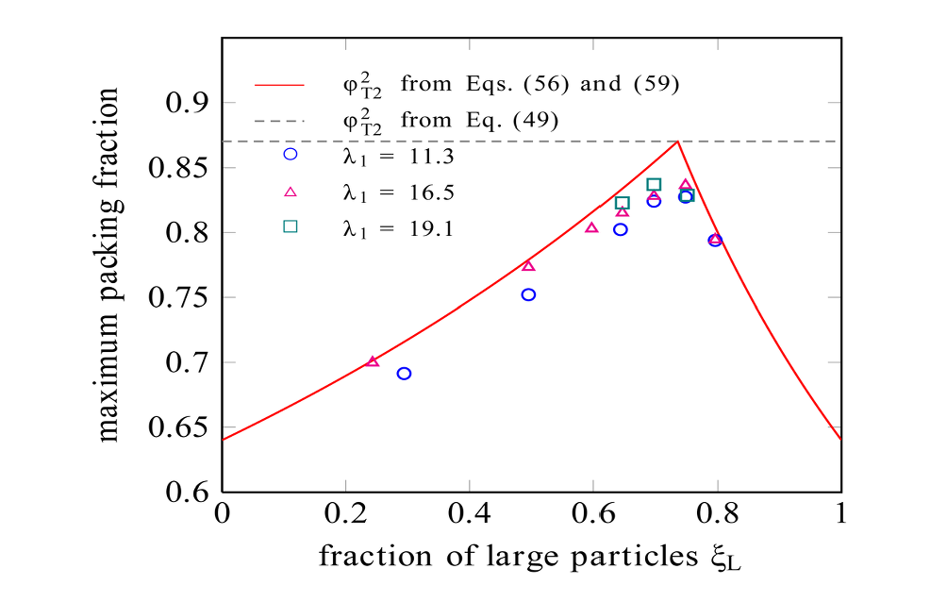
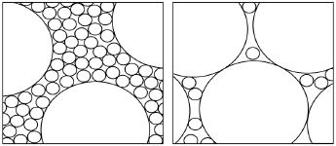
Investigation of Particle Size
Reduce the amount of binding agent used.
Upper limit of dense packing of spheres is ~64%.
So, volume of the interstitial space between the spheres is ~36%.
Filling that interstitial space with densely packed fine particles gives a percent volume of ~86%.

Slide 5
Design of the Experiment
Large particle size formation
Analysis of large particle size
Slurry formulation
Transfer molding of the slurry
Qualitative comparison of results

Slide 6
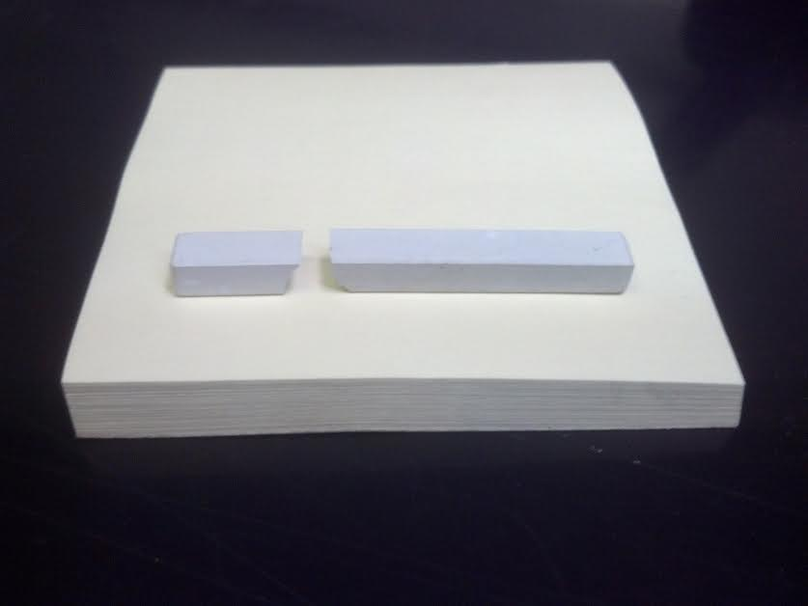
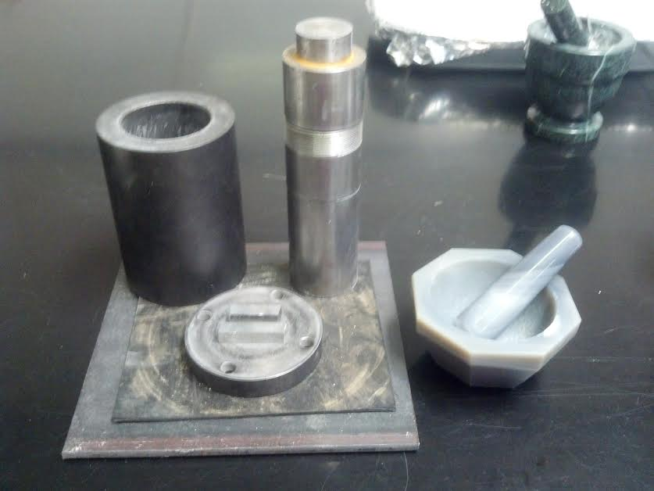
Large Particle Size Formation
Sintered silicon nitride parts were fractured.
Fractured parts were ground.
Powder was ball milled.

Slide 7
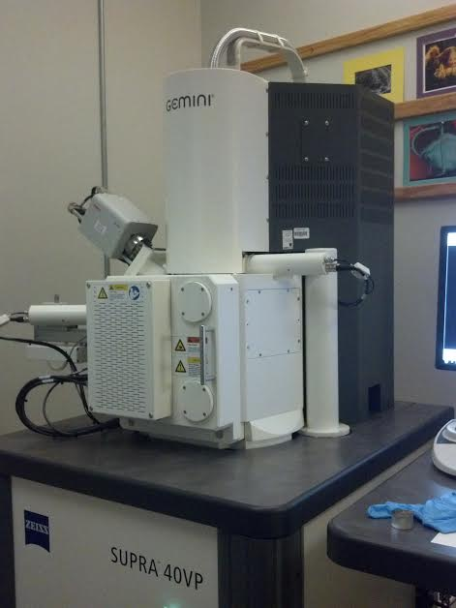
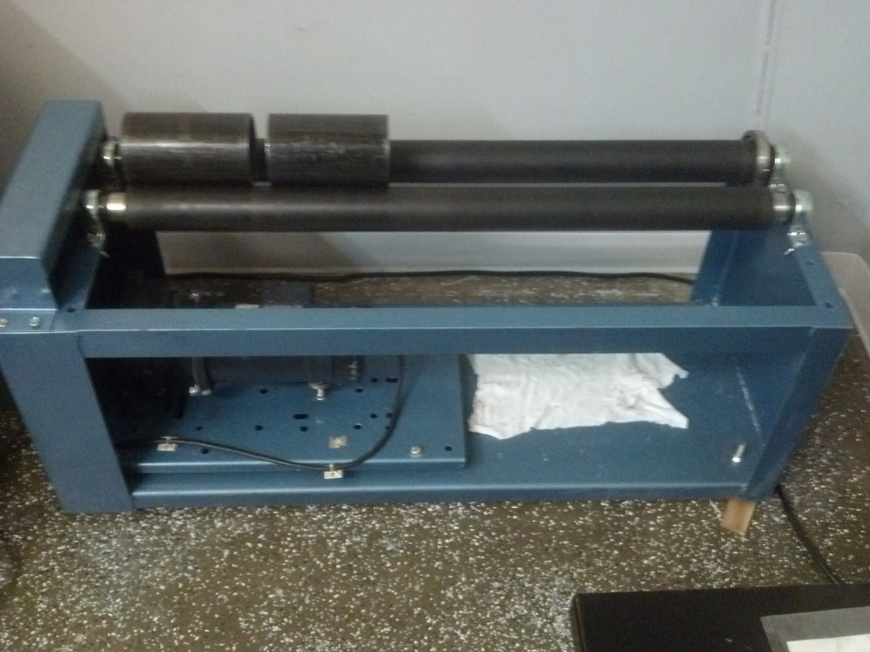
Analysis of Particle Size
Ideal ratio between large particles and small particles is 10:1.
Silicon Nitride from the manufacturer has a particle size of 2 micron.
Therefore, the ideal size of large particles is about 20 micron.
A scanning electron microscope was used to characterize the particle sizes.

Slide 8
Analysis of Particle Size
Slurry Sample 1: 10 minutes on the ball mill

Slide 9
Analysis of Particle Size
Slurry Sample 2: 30 minutes on the ball mill

Slide 10
Analysis of Particle Size
Slurry Sample 3: 70 minutes on the ball mill

Slide 11
Analysis of Particle Size
Slurry Sample 4: 150 minutes on the ball mill

Slide 12
Analysis of Particle Size
Slurry Sample 5: 300+ minutes on the ball mill

Slide 13
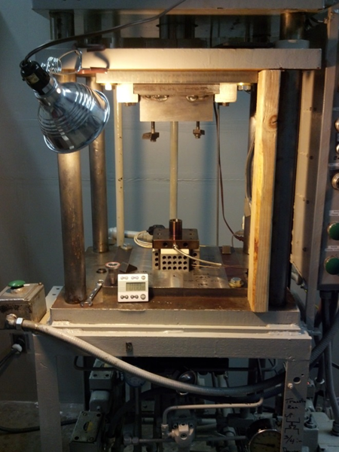
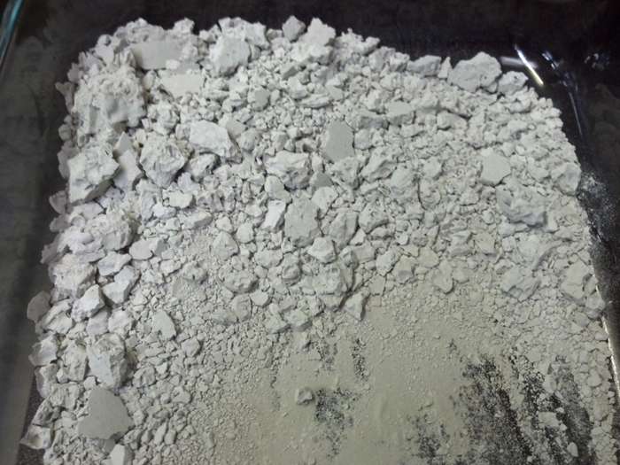
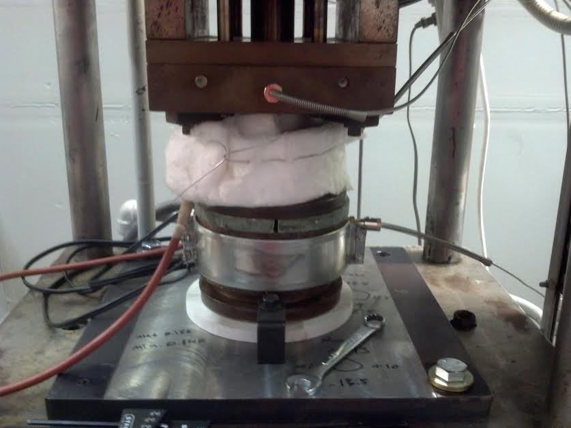
Transfer Molding of the Slurry

Slide 14
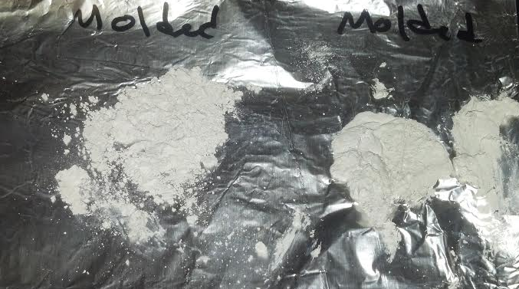
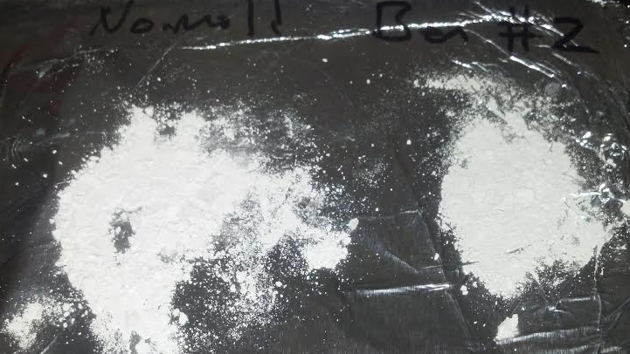
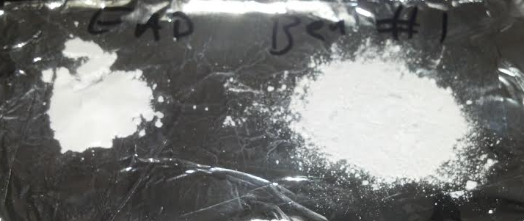
Qualitative Comparison of the Results
Good moldability.
Bad moldability.

Slide 15
Conclusions
Determined the theoretical optimum particle size distribution.
Two slurries were formed to try to mimic the optimal particle size distribution.
Two attempts were made to mold radomes from the slurries under constant conditions. Mold cavity did not fill.
By hot plate analysis, trial 1 had similar properties to the moldable material.
Improvements:
Direct testing of rheological properties.
Laser diffraction particle size analysis.
Further work is needed to fully optimize particle size distribution.

Slide 16
Acknowledgements
Arizona Space Grant Consortium
NAU Space Grant Program
Nadine Barlow and Kathleen Stigmon
ATC Materials
Mark Hawthorne and Sam Dauderman
NASA

